Slide 1


Mentorship: When Certifications, Experience, a Degree and Skills are Not Enough…
By: Brad Voris

Slide 2


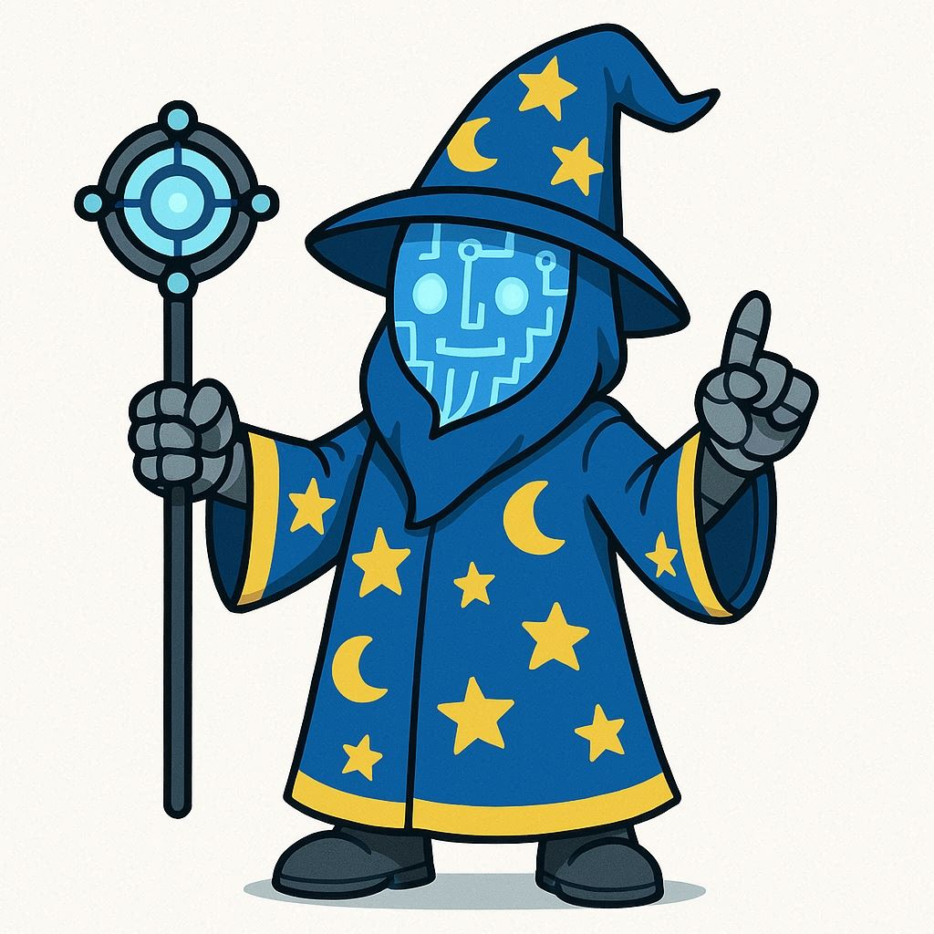
A Show of hands…
Who came here looking for a mentor?
Who came here looking to become a mentor?
Who came here looking to learn the process?
www.VictimOfTechnology.com / www.github.com/bvoris

Slide 3
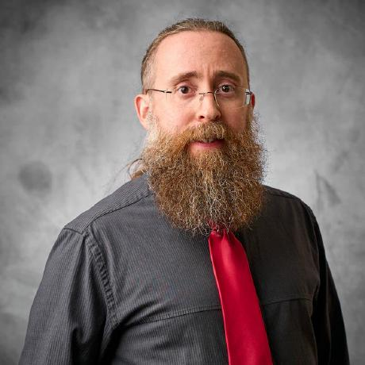
Brad Voris, (a whole bunch of acronyms)
Security Professional (Engineer/Manager/Architect)
25+ years of experience IT/IS/CS
Undergrad in Cybersecurity @ Wilmington University
Certifications: CISSP, CISM, CCSP, CCSK, Network+, MTA, MCP, etc.
Co-Author 2 books: Intrusion Detection Guide and Essentials of Cybersecurity for Peerlyst
Cloud Security Alliance Zero Trust Training Contributor
NOT AN EXPERT
www.VictimOfTechnology.com / www.github.com/bvoris

Slide 4
How do I break in to cyber?
Built a home lab…
My professor said all I needed was a degree…
Got some certs…
I’ve been in IT for years and can’t get a Security Analyst role!
Top 1% TryHackMe / HackTheBox…
I custom tailor my resume for roles but don’t get responses back!
www.VictimOfTechnology.com / www.github.com/bvoris

Slide 5




What are leaders and organizations looking for?
www.VictimOfTechnology.com / www.github.com/bvoris

Slide 6
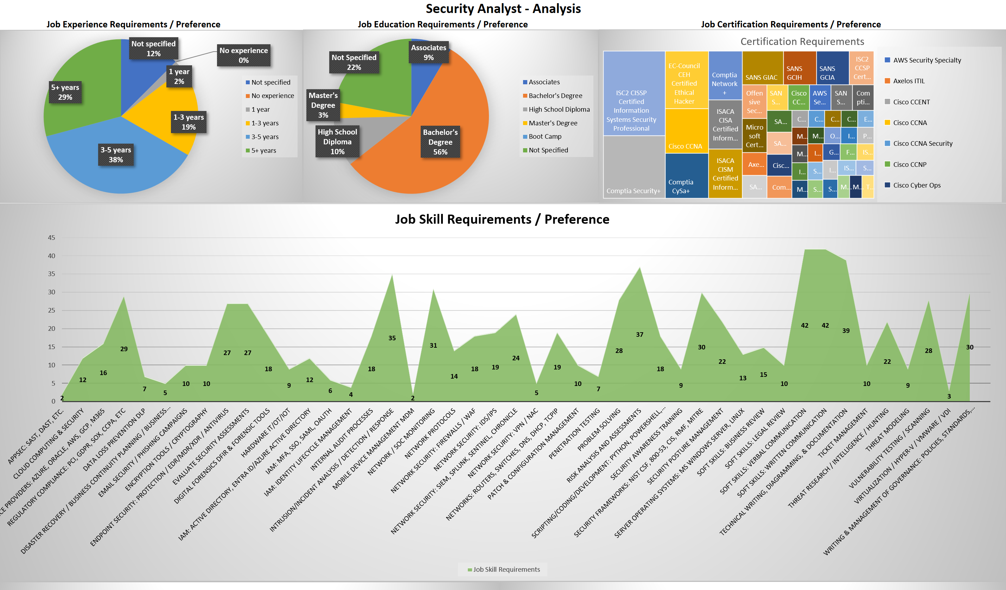
www.VictimOfTechnology.com / www.github.com/bvoris

Slide 7
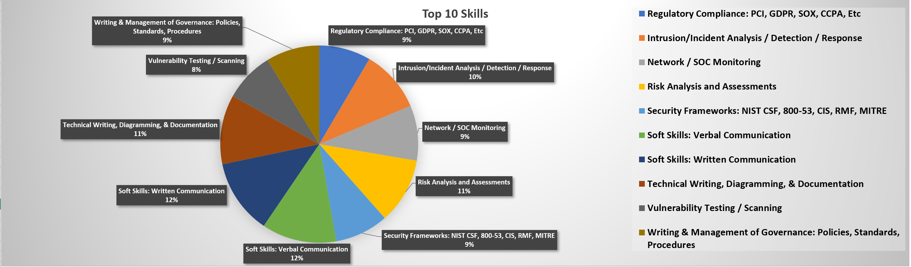

Additional Key Points:
Have a passion for learning and technology
Have fundamental knowledge of people, process, data and technology
Be flexible and adaptable with a willingness to learn
www.VictimOfTechnology.com / www.github.com/bvoris

Slide 8
What is my Mentorship Program?
Initial Connection:
Mentee will get a Career Planning Guide and instructions
Copy of current Security Analyst Research 2025
1 Hour Session:
One on One Conversation: Who I am, who you are, and what you want to do
Review of Career Planning Guide: Build a road map based on what you want to do
Network Establishment on LinkedIn
Future Sessions May Also Include:
Resume Reviews
Mock Interviews
LinkedIn Profile Reviews
Skill Assessments
Further Network Development
www.VictimOfTechnology.com / www.github.com/bvoris

Slide 9

What's the catch?
There are no fees for mentorship
Know what you want to accomplish
Be respectful of your time and mine
Frequent updates are required
Once you’ve arrived at a place in your career where you are asked to be a mentor, it is now your responsibility to help others.
www.VictimOfTechnology.com / www.github.com/bvoris

Slide 10

Q & A
www.VictimOfTechnology.com / www.github.com/bvoris

